Slide 1

How to Write Work Instructions

Slide 2
Quality Management System
I
II
III
IV
Quality Manual
System Procedures
W.I., Test Methods,
SOP’s
Records

Slide 3
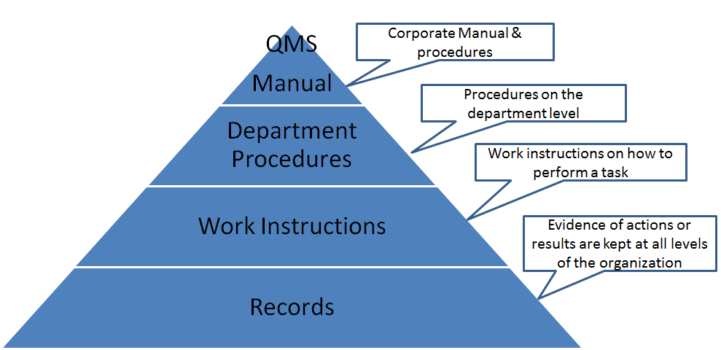

Slide 4
Quality Management System
Quality Manual—documents the intent of the organization to meet standard’s requirements. Provides a broad outline of the Quality Management System. Includes Quality Policy and Quality Objectives.
Procedures—provides information as to what is to be done to meet the requirements of the standard or the company.

Slide 5

Department Procedures
Each department has standardized procedures
Ensures uniformity of products, reporting, etc.
Some procedures tie different departments together.

Slide 6

Quality Management System (cont.)
Work instructions (SOPs)—gives details of how to do something.
Company determines how many and when appropriate.
Also depends on complexity of operation.
Records—provides a history and proof.

Slide 7
What is a Work Instruction?
A document describing specific activities and tasks containing a great amount of detail.
As a component of a process, defines how one or more activities in a procedure should be executed in detail, using technology or other resources.
A Document containing detailed instructions that specify exactly what steps to follow to carry out an Activity. A work instruction contains much more detail than a Procedure and is only created if very detailed instructions are needed.
A detailed set of instructions the describe exactly how a low-level activity must be carried out.

Slide 8

Work Instructions vs. Procedures
Procedures describe:
- What the activity is.
- Who preforms it.
- When it is preformed.
Work Instructions describe:
- How the activity is performed.
Can be used inter-changeably in many situations.

Slide 9
How to Write Work Instructions
Overview- describe what the Work Instructions does.
Objective- describe the objective and what the user can expect to happen after they have completed the activity.
Triggers- identify any triggers required to start the activity.
Inputs- describe any inputs required from other procedures/processes, department, etc.
Outputs- describe the outputs generated by the Work Instruction.

Slide 10

How to write step-by-step instructions
Describe the detailed instructions for the work. Identify roles and responsibilities.
Give each activity its own title.
One role activities. Don’t combine two roles in the same step.
Number each step.
Use consistent formatting.
Document control-Version#, Date ,Doc name, Detail of change, Review date, etc.

Slide 11

Lets Make a Paper Airplane

Slide 12

9 basic steps of writing Work Instructions
Know exactly how to do the task.
Plan how to write steps in order.
Write instructions beginning with a verb.
Write each step as a small piece.
Include warnings as pre-steps.
Write the steps in logical order.
Review and edit instructions carefully.
Express steps in the positive.
Avoid expressing opinions, preferences, or choices.

Slide 13
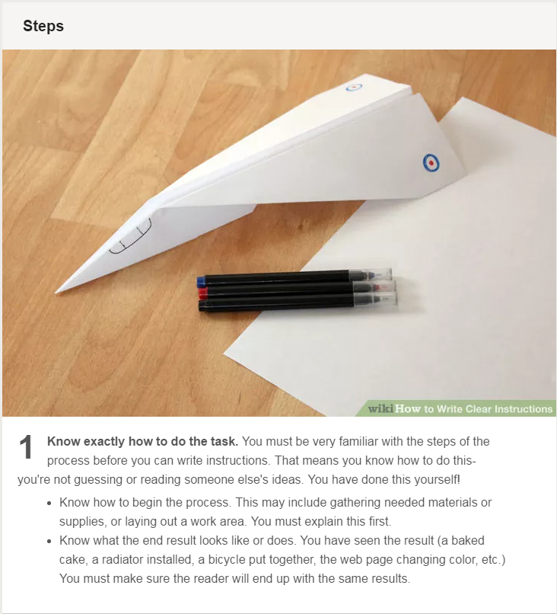

Slide 14
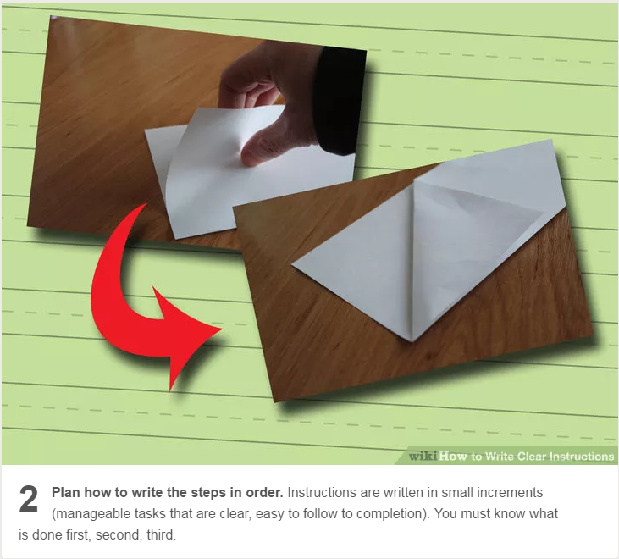

Slide 15
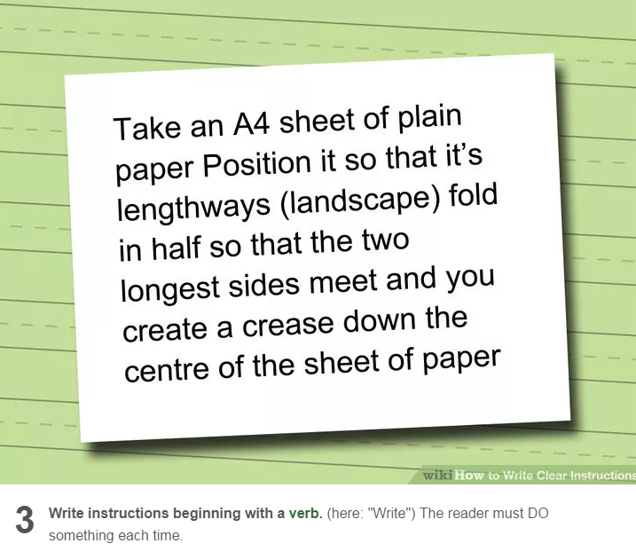

Slide 16
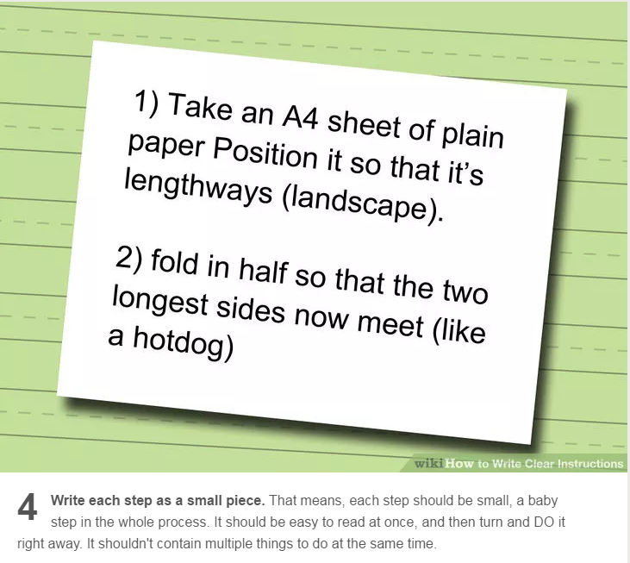

Slide 17
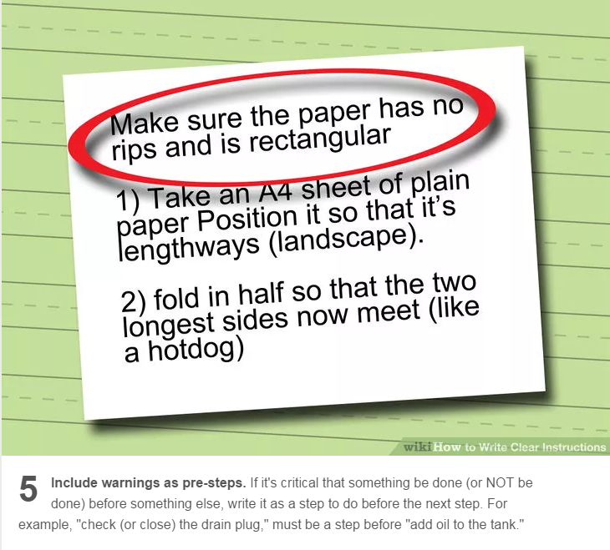

Slide 18
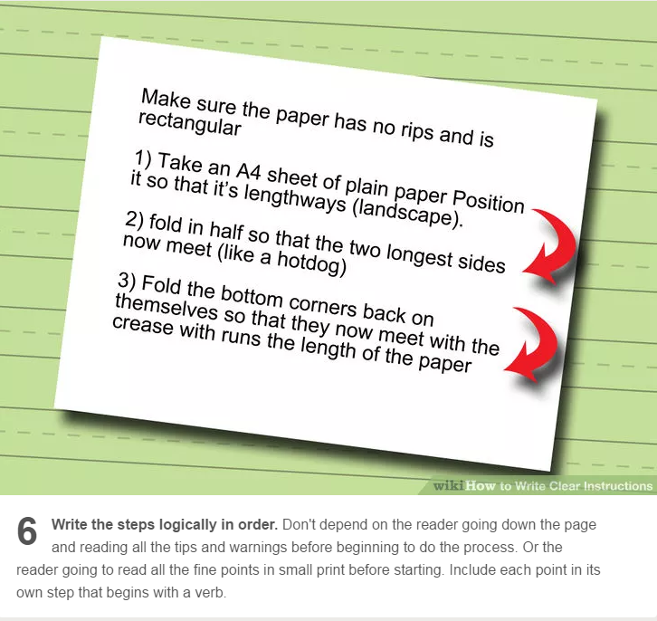

Slide 19
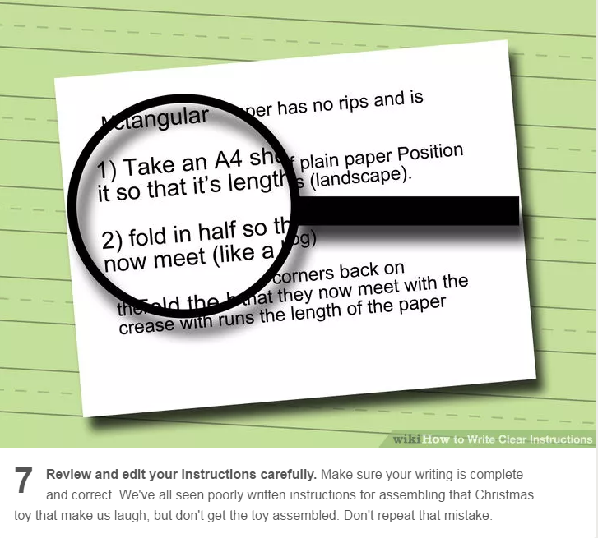

Slide 20
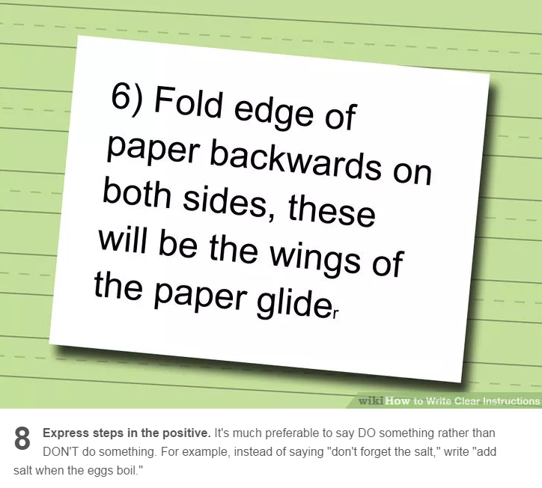

Slide 21
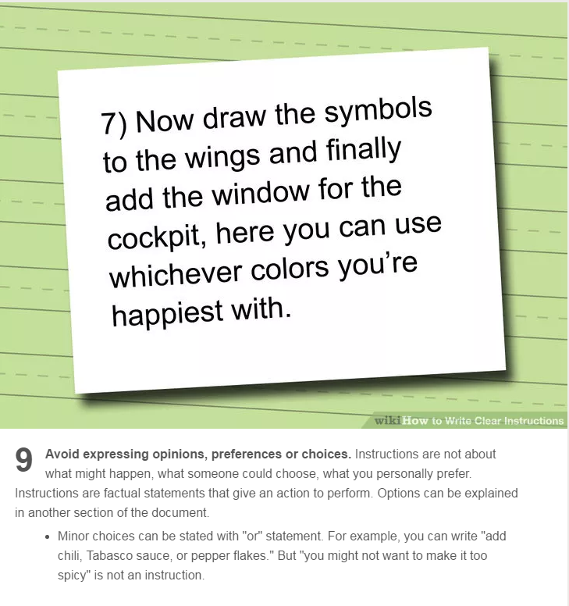

Slide 22
9 basic steps of writing Work Instructions
Know exactly how to do the task.
Plan how to write steps in order.
Write instructions beginning with a verb.
Write each step as a small piece.
Include warnings as pre-steps.
Write the steps in logical order.
Review and edit instructions carefully.
Express steps in the positive.
Avoid expressing opinions, preferences, or choices.

Slide 24

Further Discussion
?

