Slide 1
Lab Standards + Documentation Committee
June 2, 2015

Slide 2

Root Cause Analysis

Slide 3
Definition
Root cause analysis (RCA) is a class of problem solving methods aimed at identifying the root causes of problems or events.
RCA is based on the belief that problems are best solved by attempting to correct or eliminate root causes, as opposed to merely addressing the immediately obvious symptoms.

Slide 4
Principles of RCA?
Aiming corrective actions at root causes is more effective than just treating the symptoms of a problem.
To be effective, RCA must be performed systematically and conclusions must be backed up by evidence.
There is usually more than one root cause for any given problem and therefore there may be more than one corrective action.

Slide 5
General process for performing root cause analysis
Define the problem.
Gather data/evidence.
Identify issues that contributed to the problem.
Find root causes. Identify which causes to remove or change to prevent repeated problem.
Develop solution recommendations that effectively prevent repeating the problem.
Implement the recommendations / changes.
Observe the recommended solutions/changes to ensure effectiveness of eliminating the problem.

Slide 6
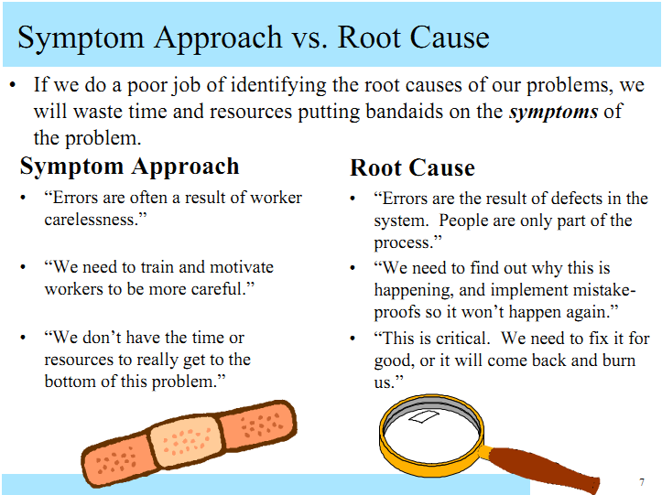

Slide 7
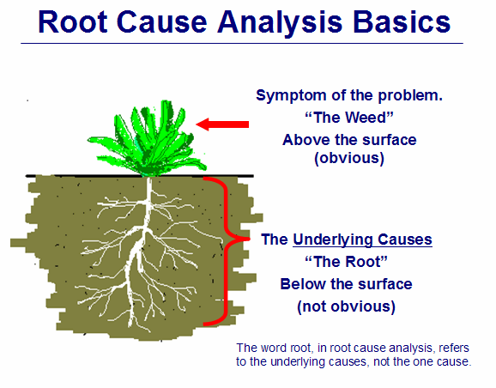

Slide 8
Cause Mapping of Root Cause Analysis
“ROOT” refers to the causes beneath the surface. It is the system of causes that shows all the options for solutions.
Do not focus on a single cause as this can limit the solutions set resulting in missing a better solution.
A Cause Map provides a simple visual look at all the elements that produced the problem.

Slide 9
Three Basis Steps of Cause Mapping
Define the issue by its impact to overall goals
Analyze the cause in a visual map.
Prevent or mitigate any negative impact of the goals by selecting the most effective solutions.

Slide 10
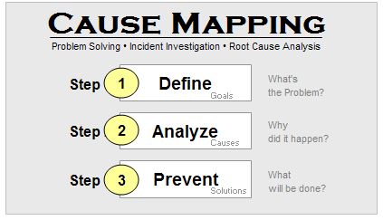

Slide 11
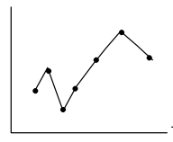
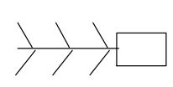
Tools for RCA
5 whys
Perato Chart
Fishbone or Ishikawa Diagram
Chart and/or Graphs
Why?
Why?
Why?
Why?
Why?
Notes:
Root Cause Analysis is critical to eliminating non-conformance and non-compliance. In this portion of the training, I'll give you some tools to use. First, I'd like to give you and example of why root cause analysis is critical.
I once did an audit on a plant that had a delivery dock. The delivery dock was located so that every time it rained, the dock became wet and very slippery. One of the workers fell and hurt himself while running across the slippery dock. The immediate response was to send him to training about safety precautions. In other words, “Don't run on the dock. Take your time.”
The dock was also coated with a non-slip material.
Six months later the man fell and was very seriously injured. He sued the company.
Problem: The root cause was not discovered the first time.
When finally asked why he was always in such a hurry, the man explained that his boss was always “ragging” him for being slow. He had been afraid of repercussions when injured the first time. Since no one asked him the first time, he decided to take the training and keep his mouth shut.
It was also discovered that the anti-slip material had worn away. No preventive-action had been taken.

Slide 12
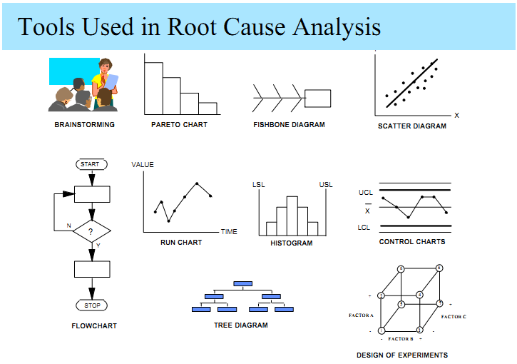

Slide 13
Ishikawa or Fishbone Diagram (Cause and effect)
Notes:
This is yet more detailed with 6 bones.

Slide 14
Brain storm possible causes

Slide 15
5 Whys
Why
Why
Why
Why
Why
Basis for the 20 questions toy

Slide 16
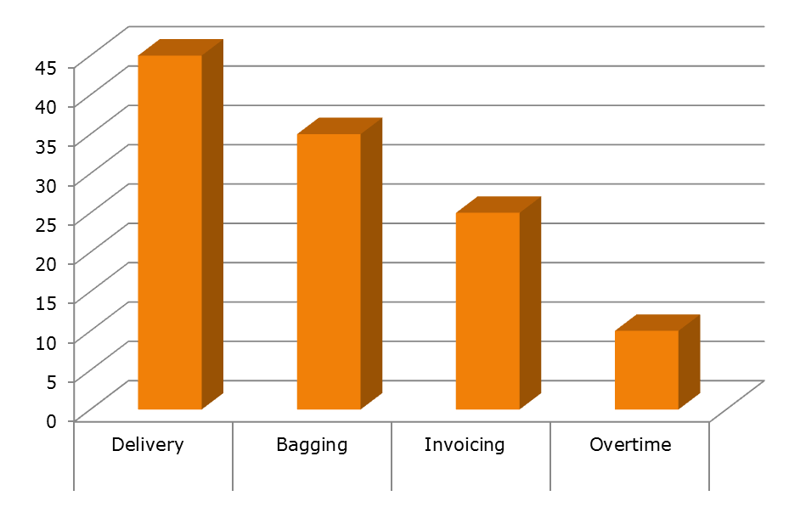
Pareto Chart
Notes:
16
How To Construct A Pareto Chart
A pareto chart can be constructed by segmenting the range of the data into groups (also called segments, bins or categories). For example, if your business was investigating the escape of GM traits, you could group the data into the following categories:
# Outside Providers
# Site Selection
# Storage
# Movement
The left-side vertical axis of the pareto chart is labeled Incident or Frequency (the number of counts for each category), the right-side vertical axis of the pareto chart is the cumulative percentage, and the horizontal axis of the pareto chart is labeled with the group names of your response variables.
You then determine the number of data points that reside within each group and construct the pareto chart, but unlike the bar chart, the pareto chart is ordered in descending frequency magnitude. The groups are defined by the user.
Questions The Pareto Chart Answers
What are the largest issues facing our team or business?
What 20% of sources are causing 80% of the problems (80/20 Rule)?
Where should we focus our efforts to achieve the greatest improvements?

Slide 17
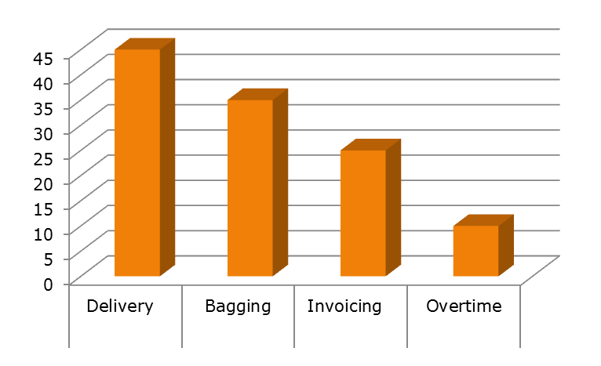
Defining the problem
The tackle is the one that has the highest score. This one will give you the biggest benefit if you solve it.

Slide 18
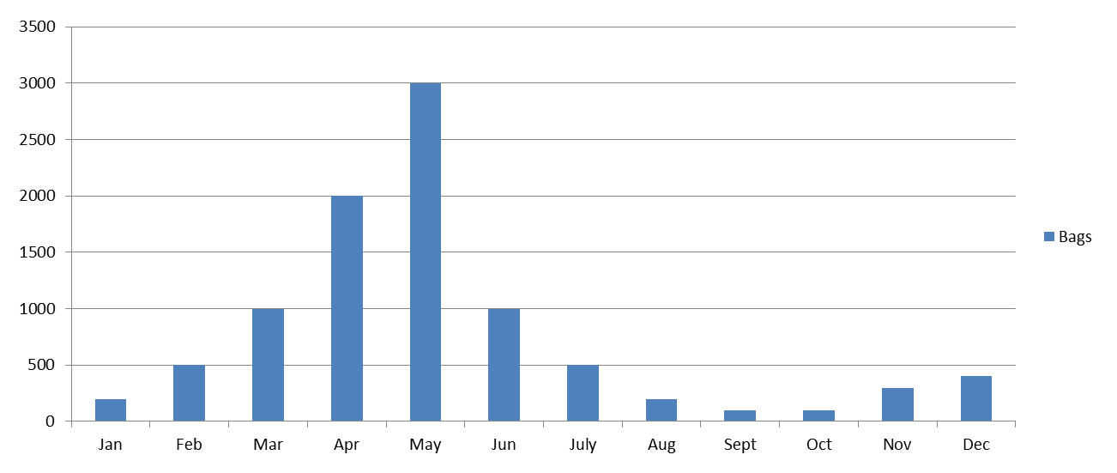
Charts and Graphs

Slide 19
7 Best Practices to Remember
Your root cause analysis is only as good as the info you collect.
Your knowledge (or lack of it) can get in the way of a good root cause analysis.
You have to understand what happened before you can understand why it happened.
Interviews are not about asking questions.
You can’t solve all human performance problems with discipline, training, and procedures.
Often people can’t see effective corrective actions even if they can find the root cause.
All investigations do not need to be equal (but some steps can’t be skipped.

Slide 20
