Slide 1
2018-2019 LETTUCE TZ PROFICIENCY

Slide 2
PARTICIPANTS
172 PARTICIPANTS
  2 CSAAC
  7 CSAAC/RST
  2 CSA IN GERM
  9 CSA IN PURITY AND GERM
  12 CVT
  1 CSAG/CVT
  95 RST
  14 RST/CSA IN PURITY AND GERM
  30 NOT ACCREDITED

Slide 3
RESULTS
Average TZ was a 90%
Results ranged from an 18% to a 100%
153 individuals were within one standard deviation
9 individuals were within two standard deviations
  Of these two are non accredited individuals
10 individuals were outside two standard deviations
  Of these four are non accredited individuals

Slide 4
NUMBER OF SEEDS
5 INDIVIDUALS TESTED 400 SEEDS
  4 were within 1 standard deviation
  1 was within 2 standard deviations
1 INDIVIDUAL TESTED 160 SEEDS
  Was outside 2 standard deviations
1 INDIVIDUAL TESTED 100 SEEDS
  Was within 1 standard deviation
165 INDIVIDUALS TESTED 200 SEEDS
  149 were within 1 standard deviation
  8 were within 2 standard deviations
  9 were outside 2 standard deviations
Rules require a minimum of 200 seeds be tested for a stand alone TZ Test

Slide 6
COMMENTS
Why a lettuce TZ? Germination test is only 7 days
Most seeds sprouted overnight.
Called sprouted viable
Sample showed necrosis
Difficult to interpret
Conducted germ test prior to TZ. Germ showed necrosis
Did not know necrosis was detectable with a TZ test

Slide 7
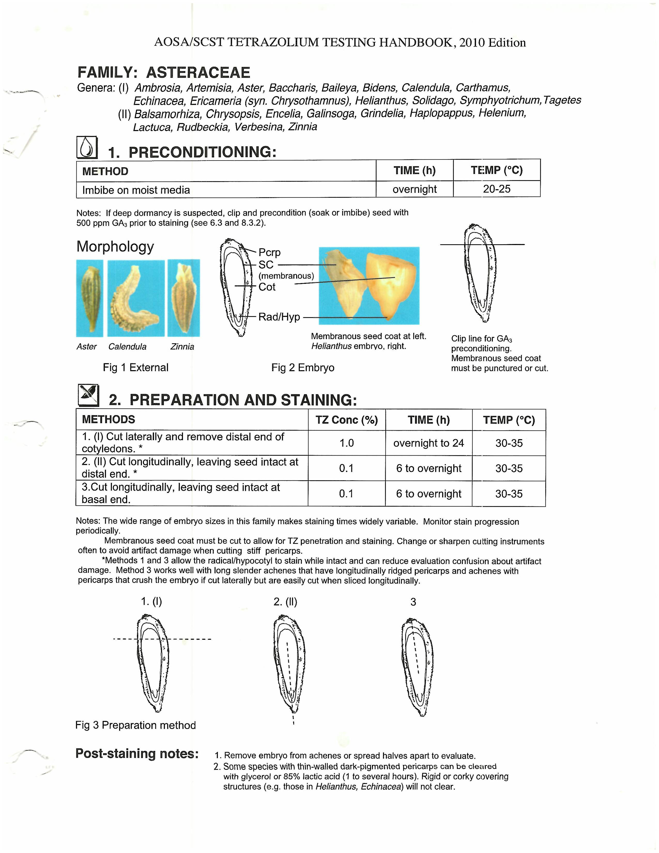
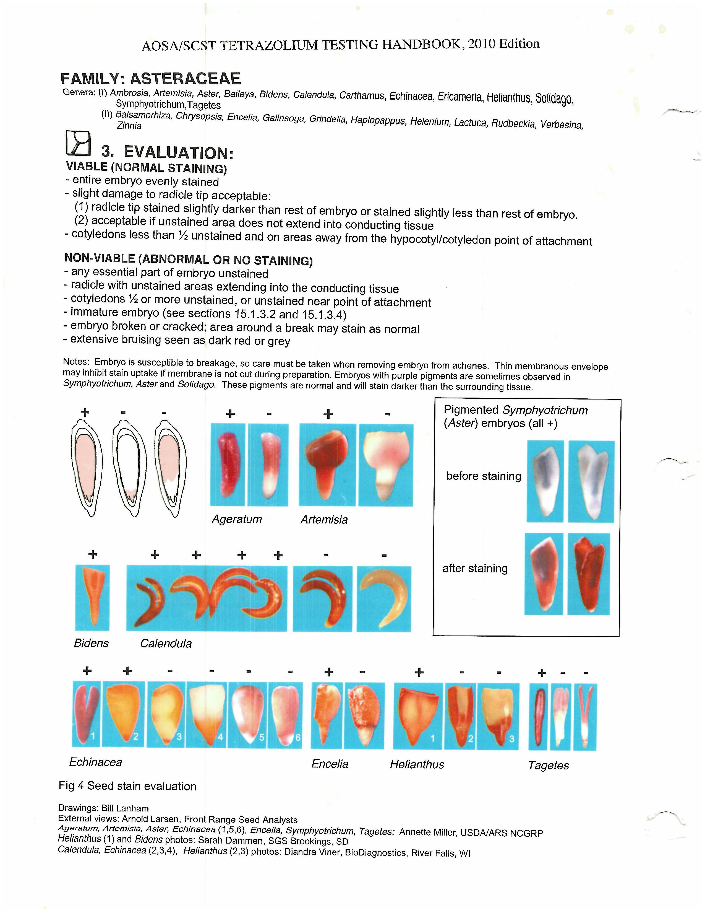

Slide 8
TZ Handbook for Lactuca sativa
Family Asteraceae Genera (II)

Slide 9
PREPARATION

Slide 10
EVALUATION

Slide 11
DETECTING NECROSIS IN LETTUCE TZ
Consulted with TZ committee since no where in the TZ handbook does it state anything about determining necrosis in lettuce TZ. It warns of artifact damage and to ensure membranous covering is cut open.
Lettuce sample was necrotic but most of the necrotic lettuce stained normally and must be called viable.
Considered unviable
  Any essential part of embryo unstained
  Radicle with unstained areas extending into the conducting tissue
  Cotyledon ½ or more unstained or unstained near the point of attachment
  Immature embryo
  Embryo broken or cracked
  Extensive bruising seen as dark red or gray

